Slide 1
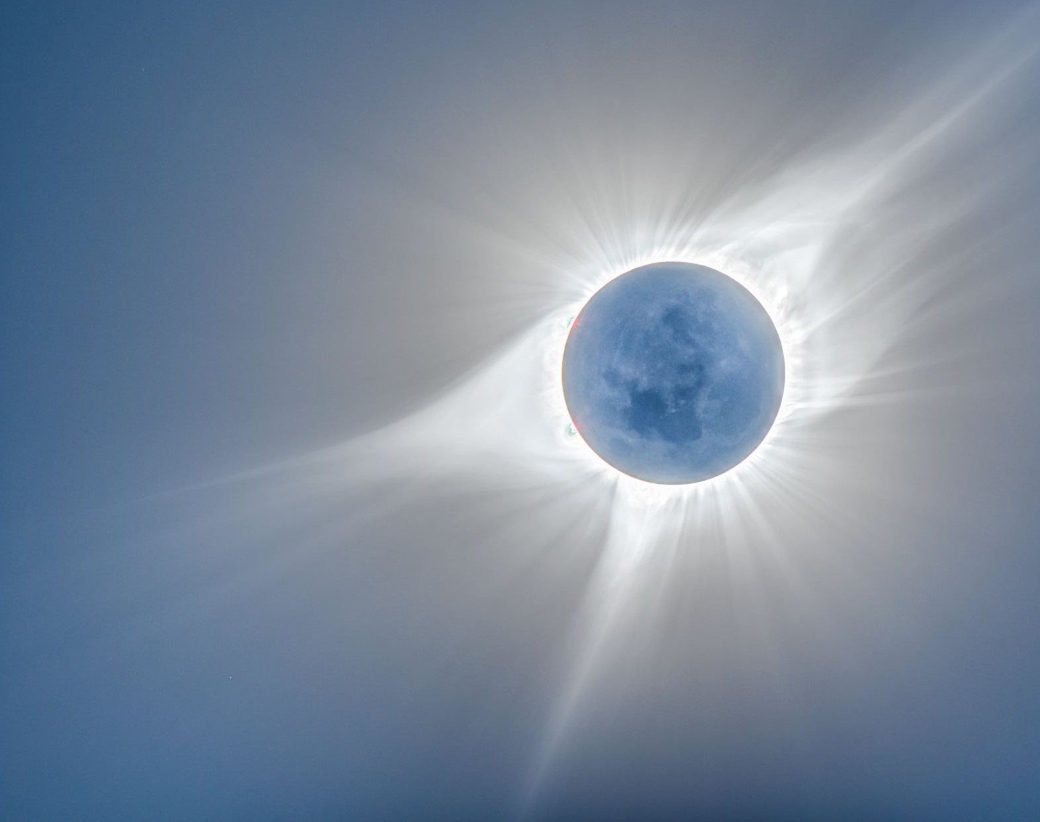
Ray Marching of a Procedural "Planet"
Team 4:
Yuxiang Lin
Xiangnan Hu
Sardor Akhmedjonov
Tuguldur Davaanyam

Slide 2
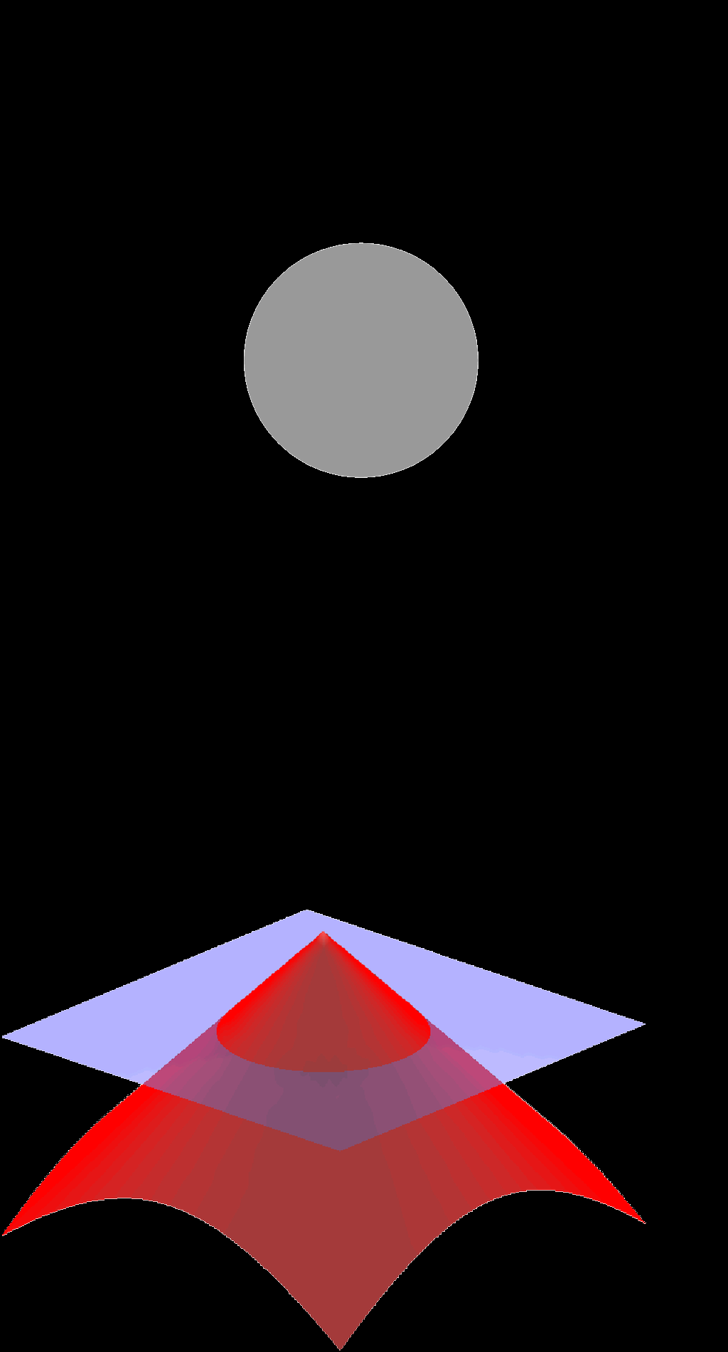
Signed Distance Function
Maps a point p in 3D space to a distance f(p).
Positive if the point is outside of the object.
Zero if the point is on the surface of the object.
Negative if the point is inside of the object.
Sometime equal to the signed Euclidean distance to the object surface, but more often a distorted distance (not the real distance).

Slide 3
Rendering Process
Cast Ray
For each pixel in the screen, generate a ray from the origin.
Ray March
Ray march to find the object hit by the ray; each step advance by the distance to the closest object.
Material
Get the material of the object hit.
Shadow Ray
Cast shadow ray towards the light source to see if the intersection point is occluded by other objects.
Normal
Calculate surface normal using finite difference.
Lighting
Calculate lighting (diffuse and specular).
Effects
Apply fog.
Draw
Draw pixel.

Slide 4
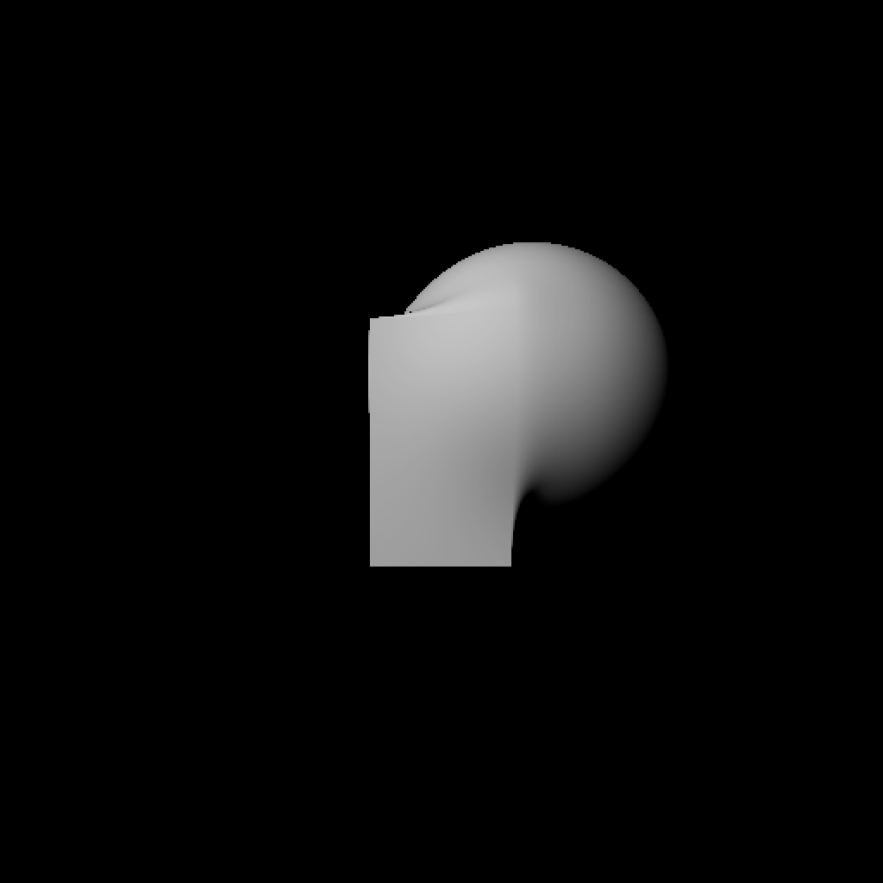
Smooth Polynomial Min
Min of distances: The union of the objects (the distance to the union of the objects is equal to the minimum of the distances to individual objects).
Using a smooth polynomial function to connect the points x0, x1 together,
where f(x0) - g(x0) = k and g(x1) - f(x1) = k.

Slide 5
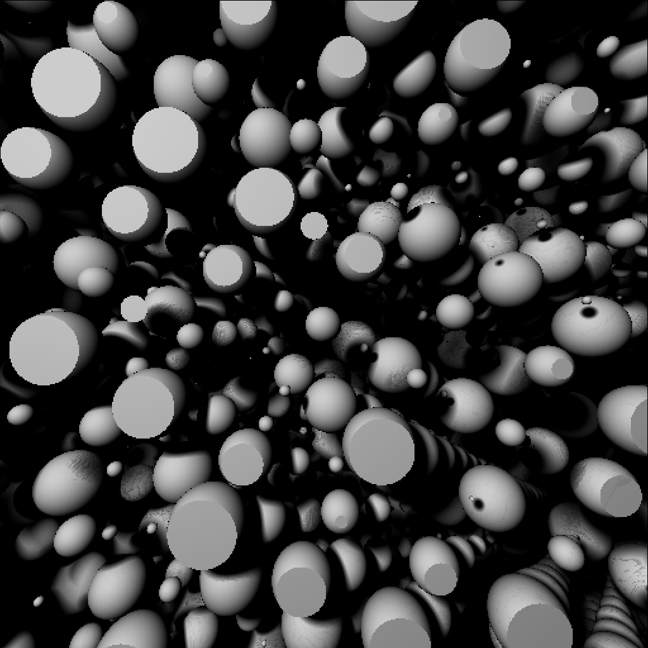
Soft Shadows
For the shadow rays that are close to an object, consider the origins to be partially shaded.
Multiply the light transmitted by the distance from the shadow ray to the closest object divided by the distance travelled when travelling along the shadow ray.
(Shadow ray close to an object transmit less light.)

Slide 6

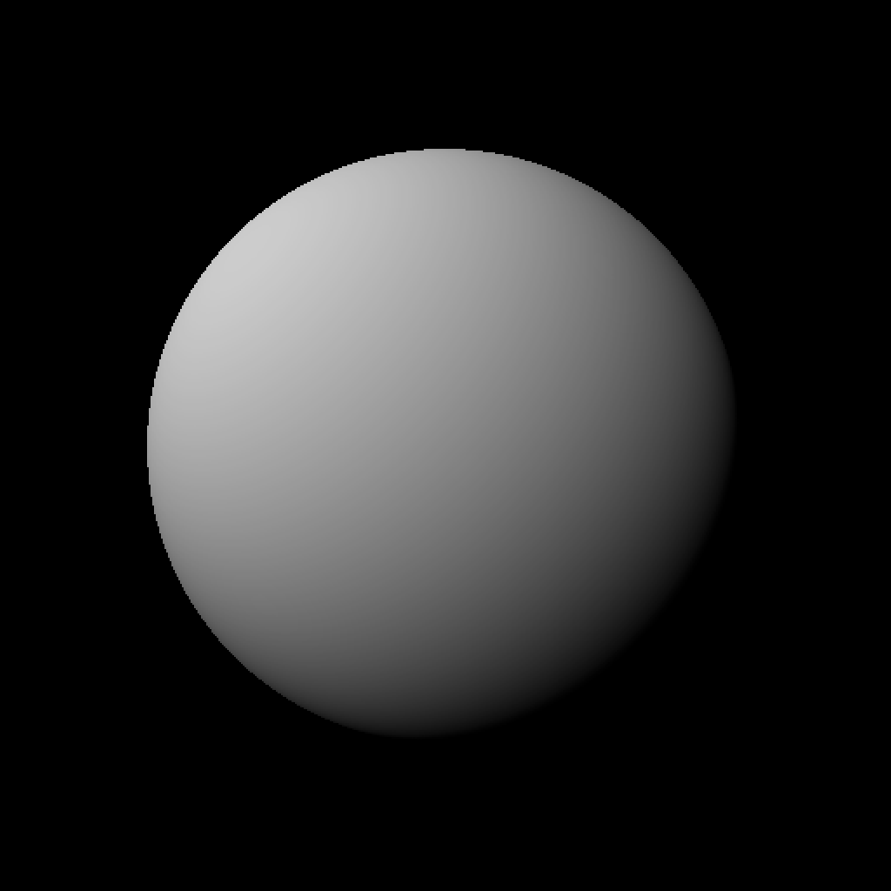
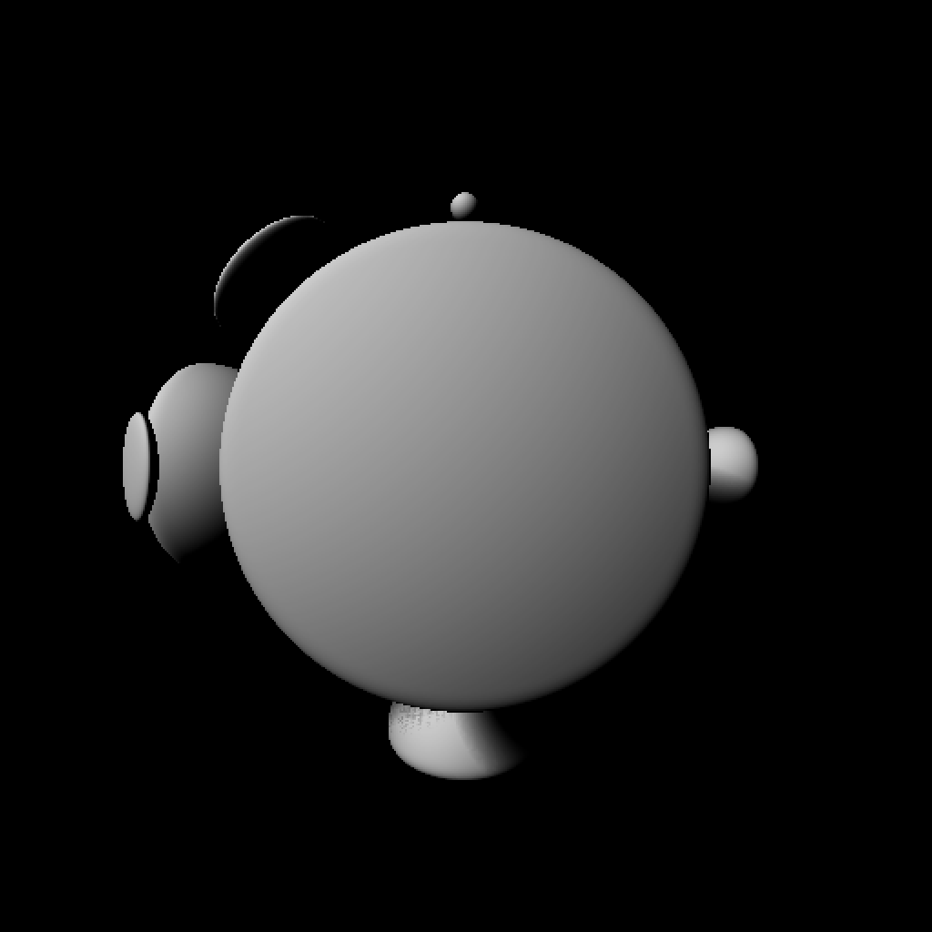
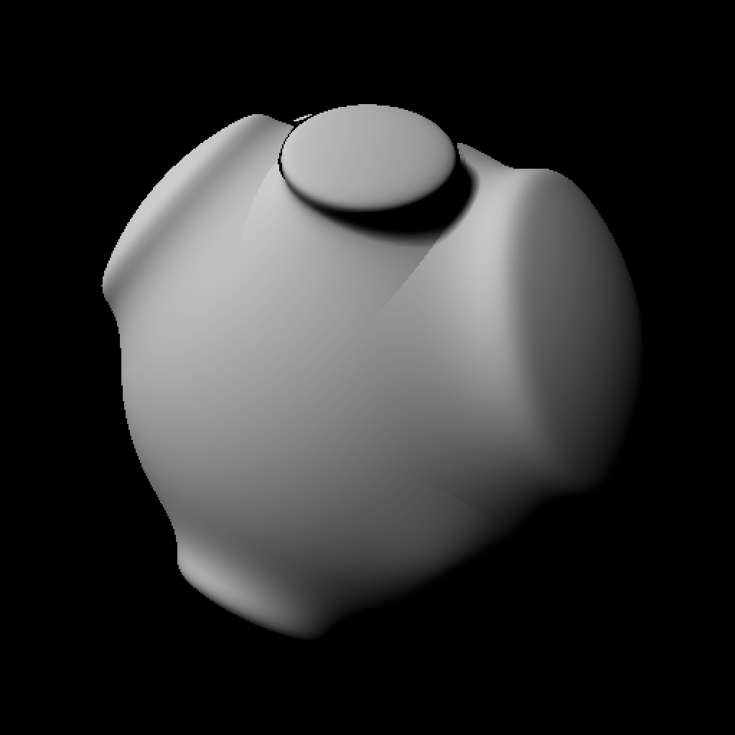
Fractional Brownian Motion
Glue the clipped part of the noise onto the host sphere using smooth min.
Do a rotation to prevent visual artifacts resulting from axis-aligned grid of spheres.
Then repeat the process with a scaled-down version of the sphere grid.
Generate an infinite grid of spheres of infinite sizes (a layer of noise).
Clip the spheres with an inflated version of host sphere using smooth max function.
Host sphere.

Slide 7
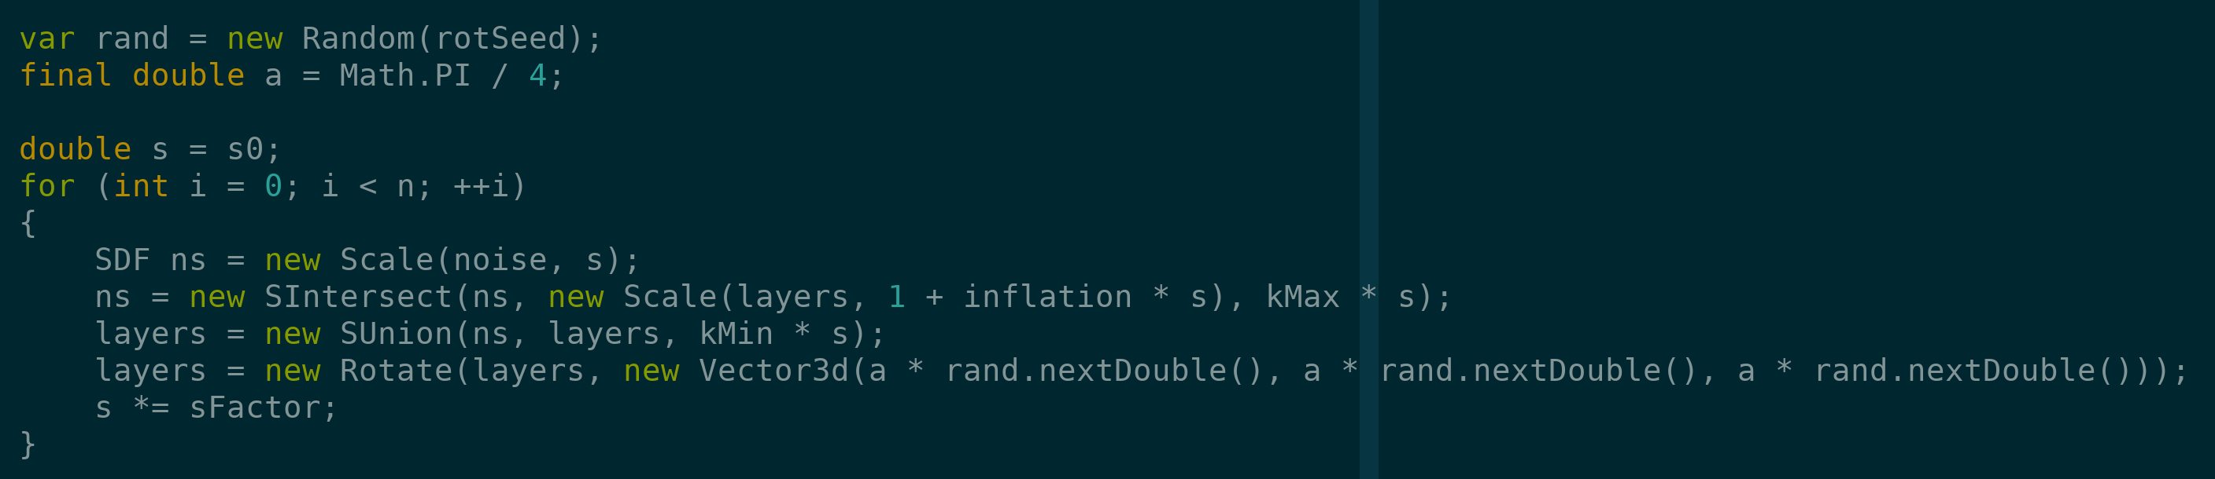
Implementation

Slide 8
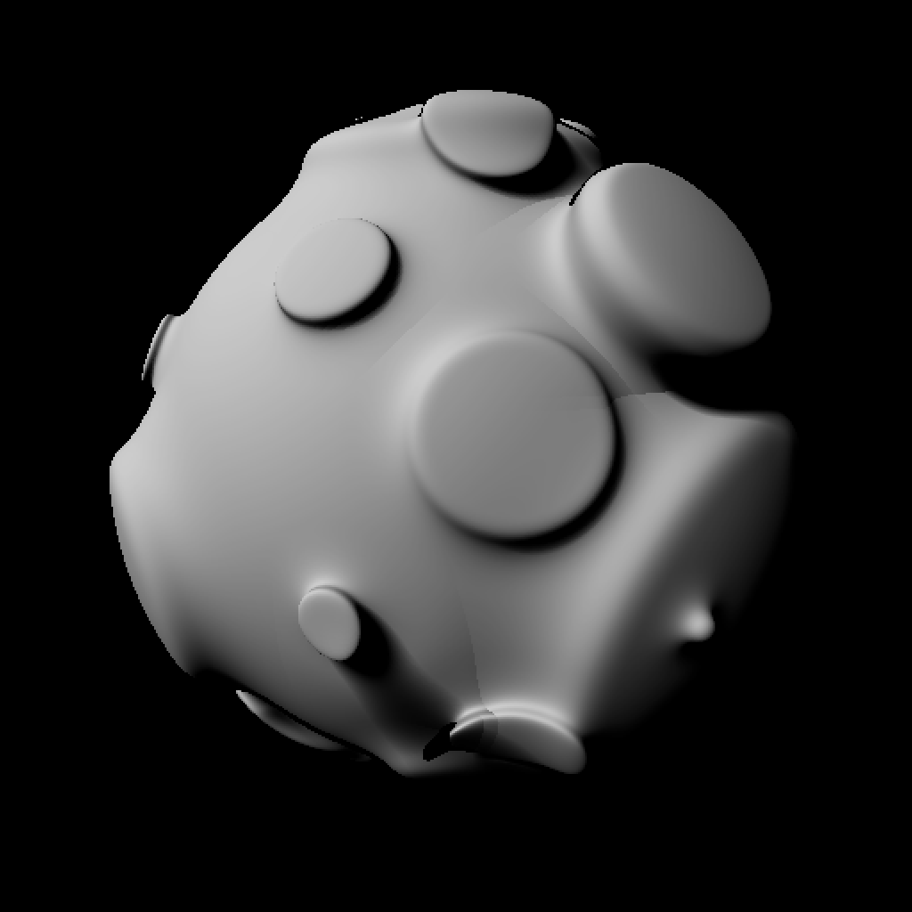
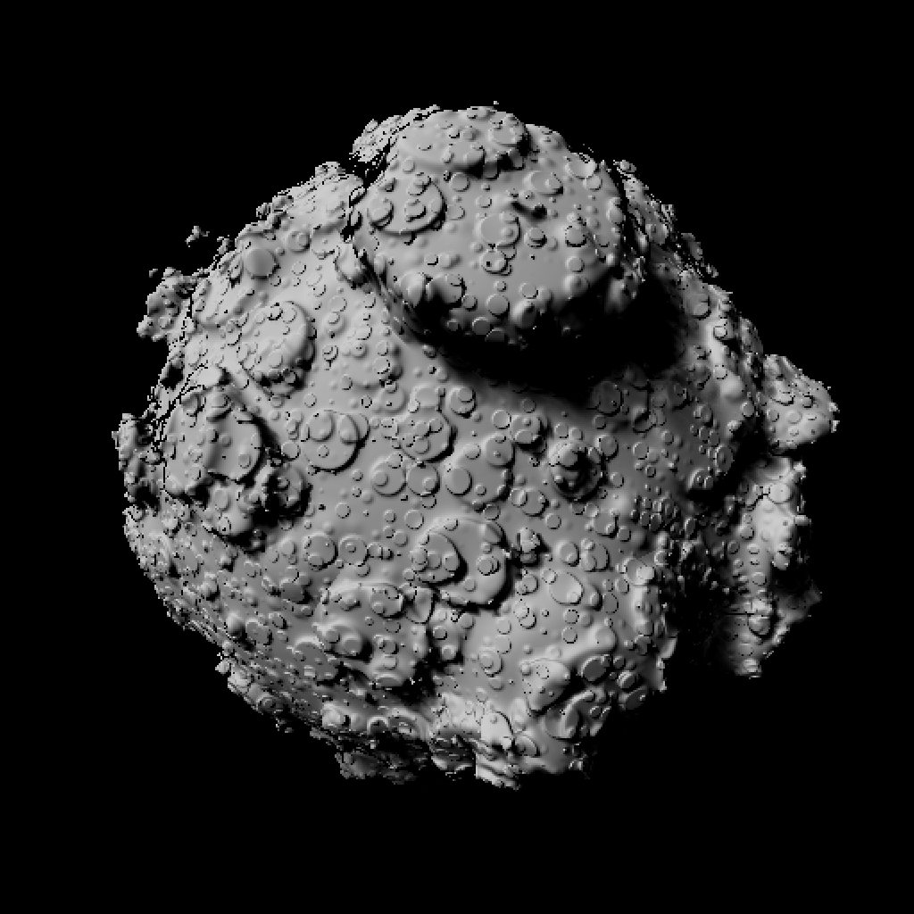
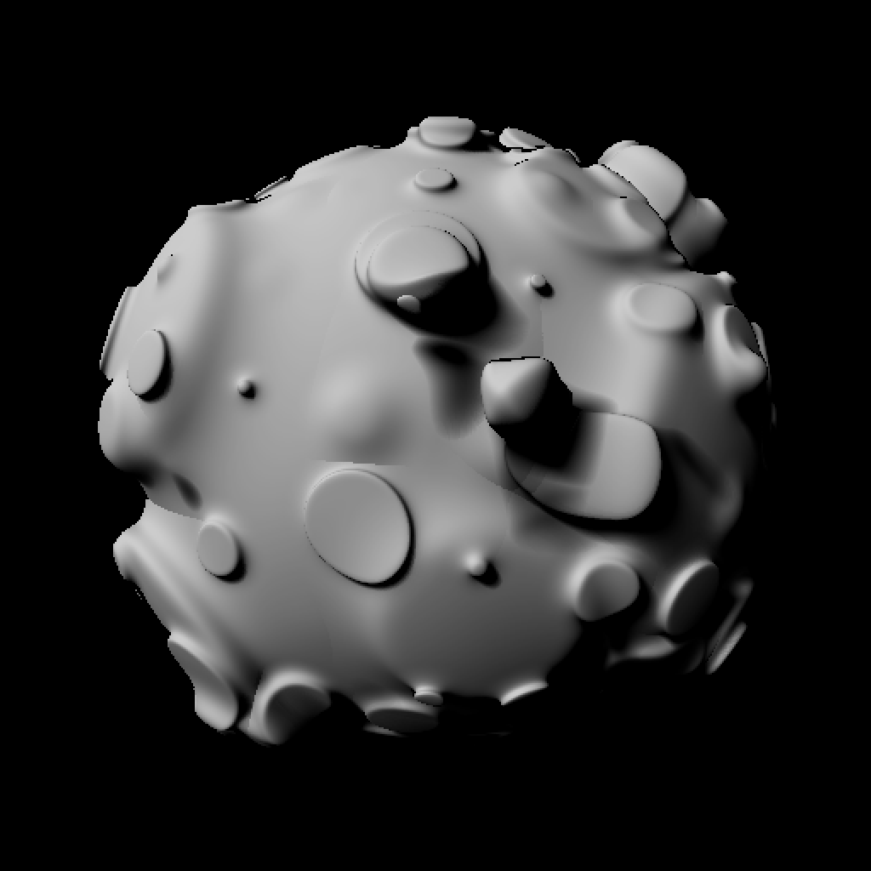
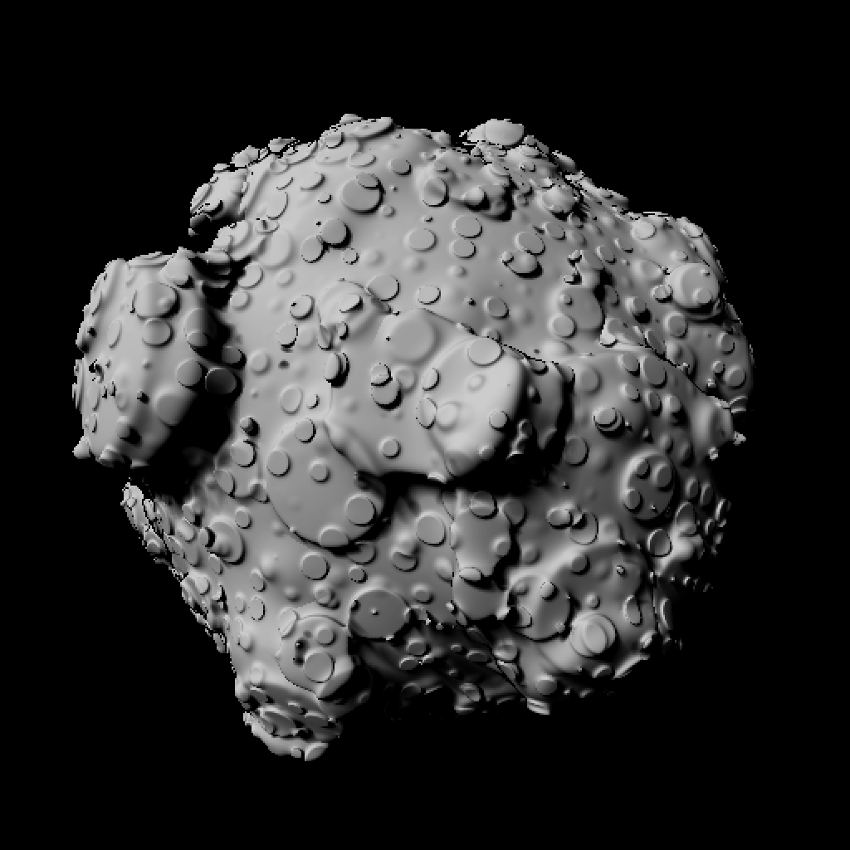
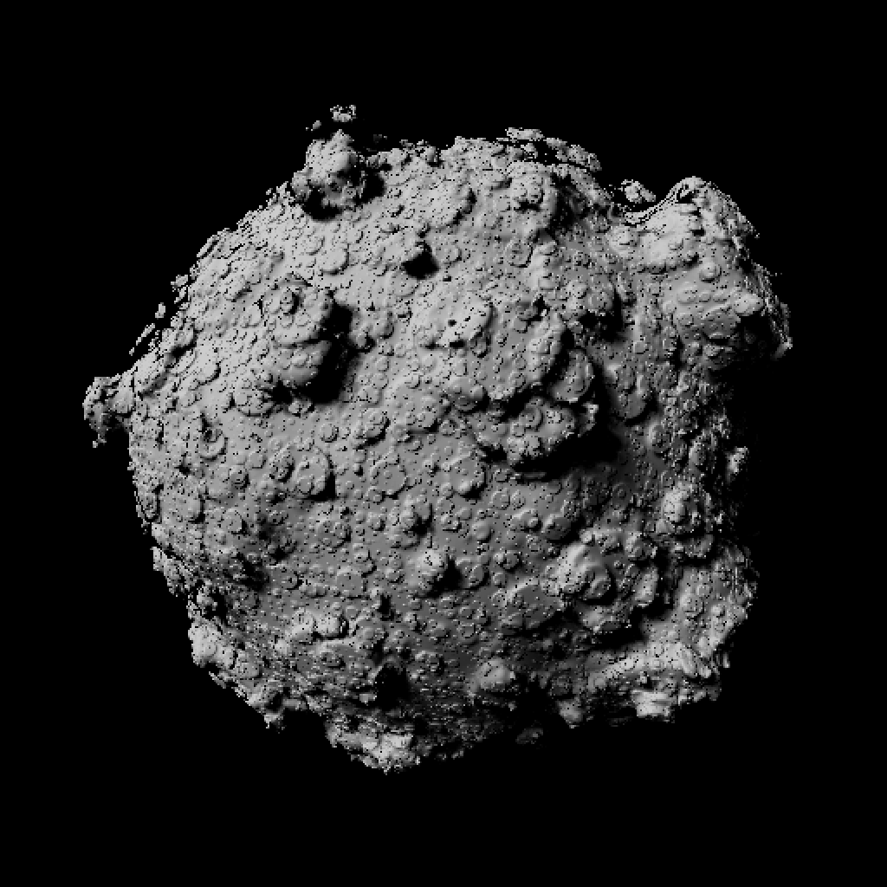
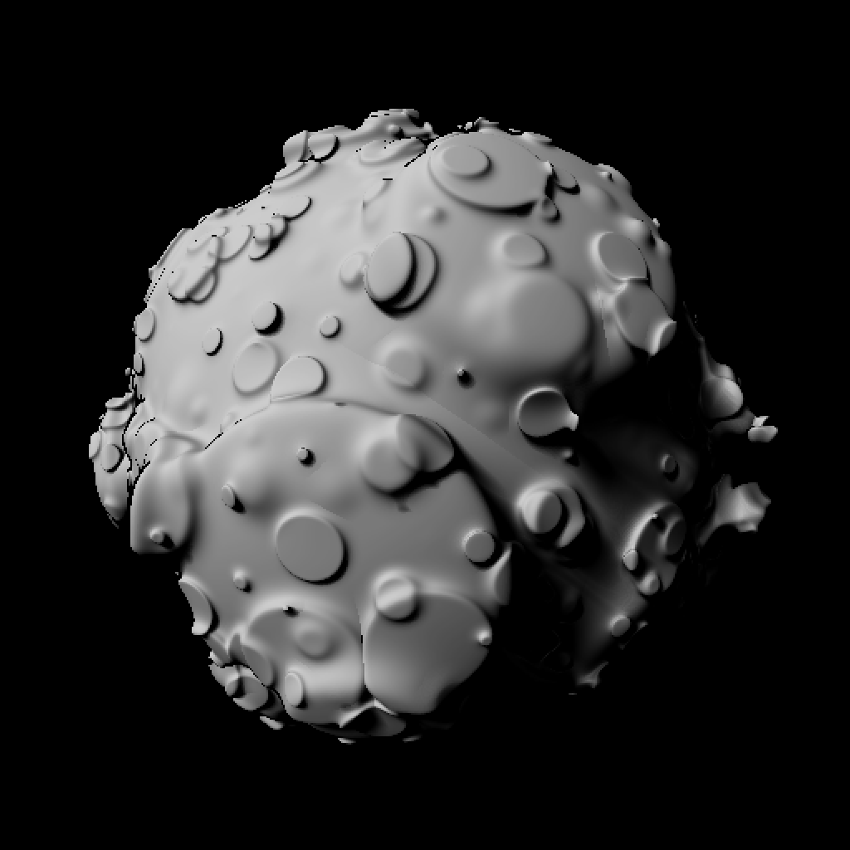
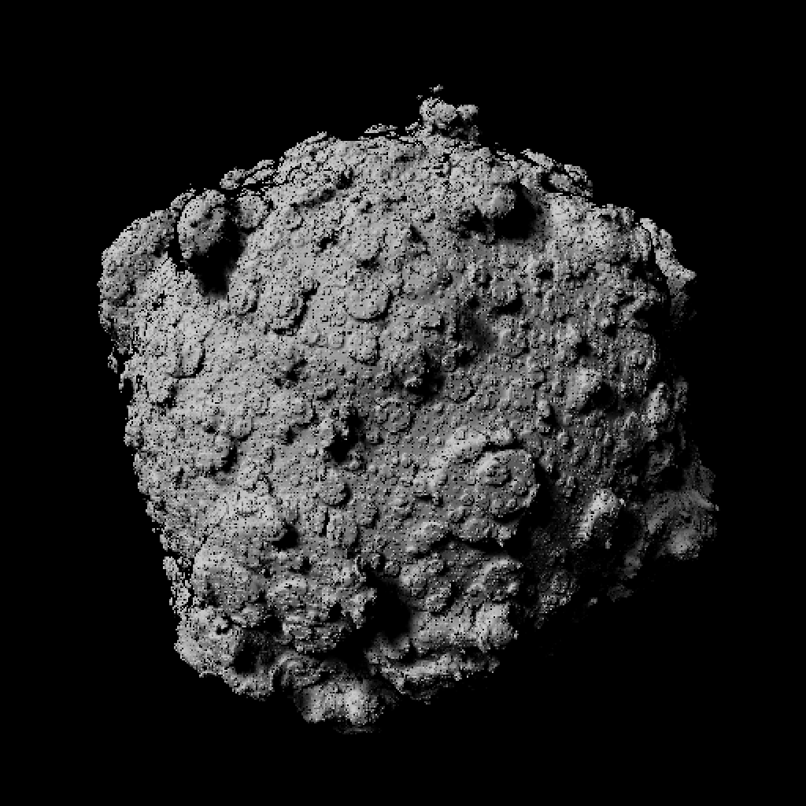
Add 1 to 8 Layers of Noise to the Sphere

Slide 9
Rendering Time
1 Layer: 2.413 s
2 Layers: 6.367 s
3 Layers: 14.433 s
4 Layers: 39.096 s
5 Layers: 79.351 s
6 Layers: 170.238 s
7 Layers: 349.598 s
8 Layers: 705.503 s

Slide 10
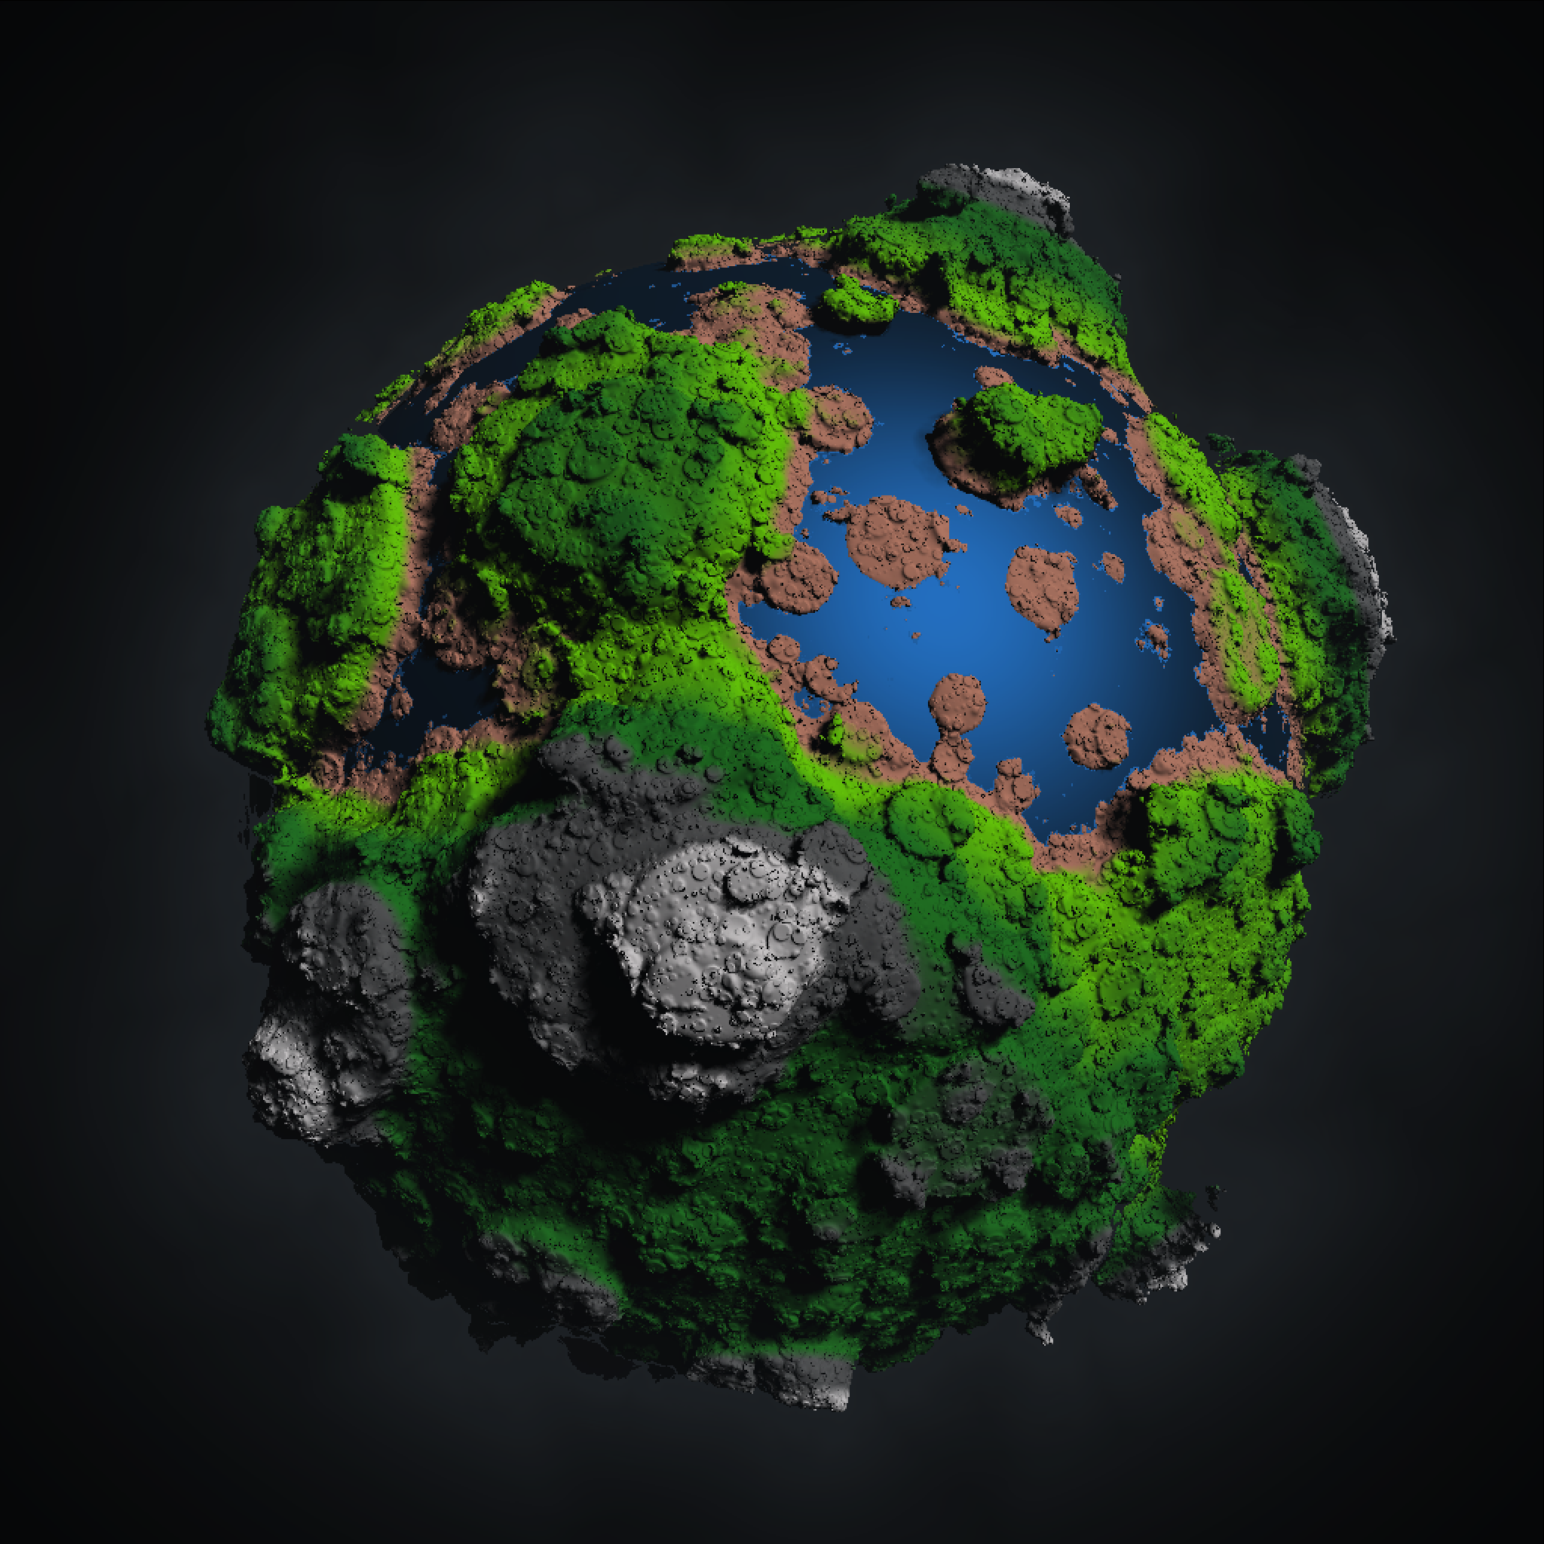
Final Rendering Result
Add color according to elevation.
Add "water."
Add fog effect.
Rotate the object to a better angle.
Change resolution from 512x512 to 1024x1024.
Rendering time: 3568.38 s.

Slide 11
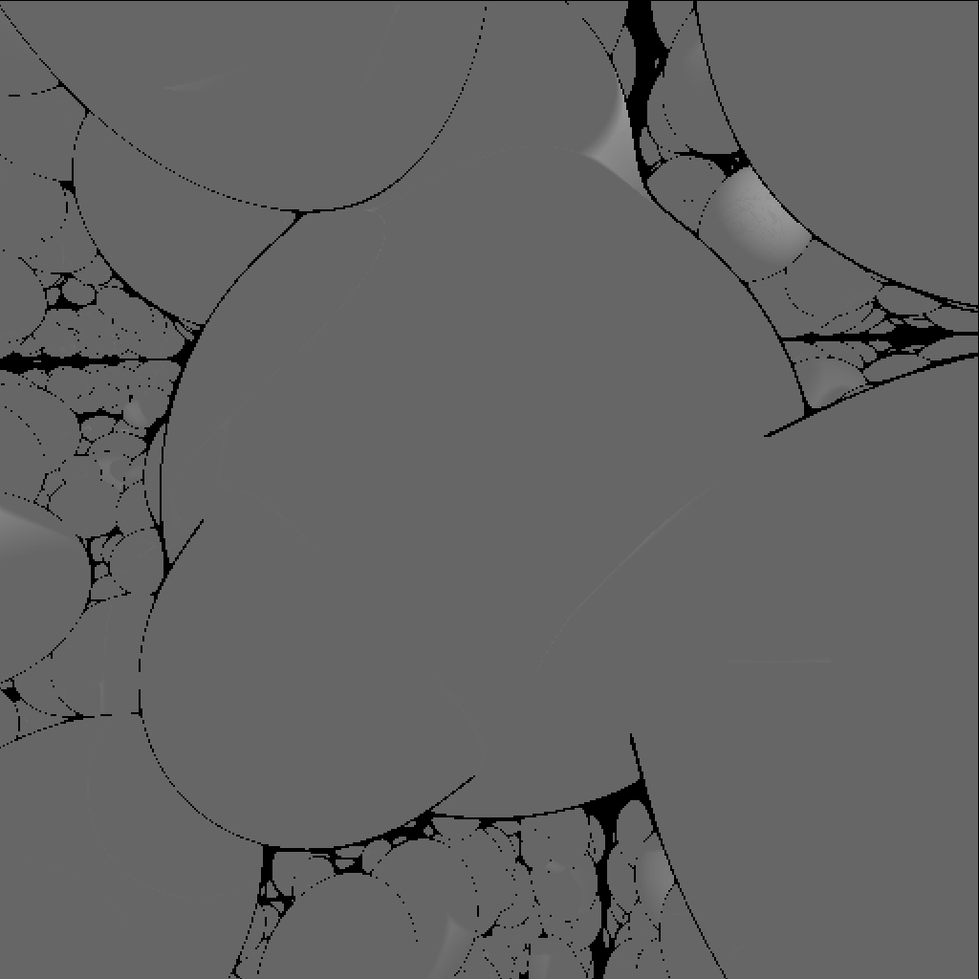
Quiz
What will happen if we don't clip (take the max of the distance functions) the random grid of spheres to the inflated version of the host sphere?

Slide 12

Q&A

Slide 13
References
https://github.com/ssloy/tinyraytracer/wiki/Part-1:-understandable-raytracing
https://github.com/ssloy/tinykaboom/wiki/KABOOM!-in-180-lines-of-code
https://iquilezles.org/articles/smin/
https://iquilezles.org/articles/rmshadows/
https://iquilezles.org/articles/fbmsdf/
https://iquilezles.org/articles/distfunctions/
https://iquilezles.org/articles/fog/

Slide 14
GitHub Link
https://github.com/theta-lin/cs_201_bk_2

